Slide 1
Logic Gates
CSE 4205: Digital Logic Design
Aashnan Rahman
Junior Lecturer
Department of Computer Science and Engineering (CSE)
Islamic University of Technology

Slide 2
01
Logic Gates
Device performing logical operations

Slide 3
Logic Gates
An electric circuit that operate on one or more input signals to generate an output signal based on specific requirement(s)

Slide 4
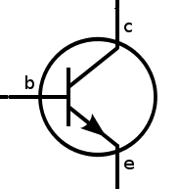
Switching Circuits / Binary Signal
Binary logic variable A can be represented as a switch A as following :
switch ON
logic 1
switch OFF
logic 0
Electronic digital circuits uses transistors as switches
Conduct current → switch on
Doesn’t conduct current → switch off

Slide 5
02
Basic Gates
Building blocks used in digital electronics

Slide 6
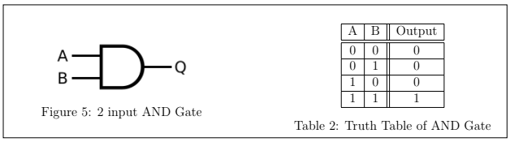

AND Gate
It produces a high output (logic 1) only when all of its inputs are high; if any input is low (logic 0), the output will also be low.

Slide 7
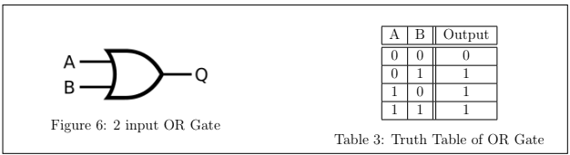

OR Gate
Outputs a high signal (logic 1) if at least one of its inputs is high. If all inputs are low (logic 0), only then will the output be low.

Slide 8
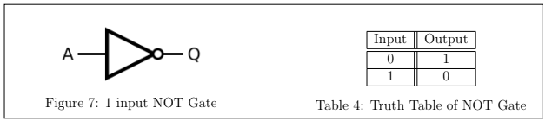

NOT Gate
It operates on a single input and a single output. It performs a logical inversion.

Slide 9
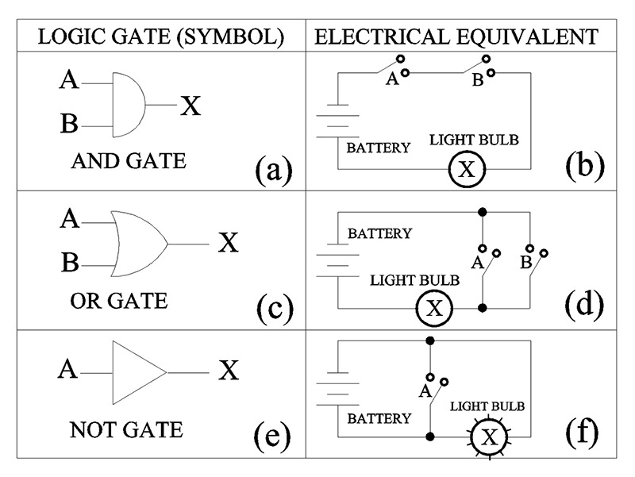
Equivalent Circuits

Slide 10
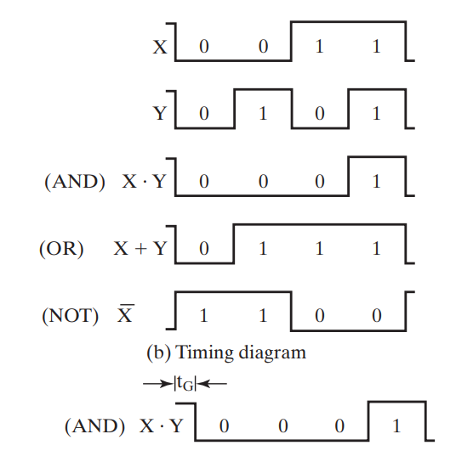
Timing Diagram

Slide 11
Gate Delay
Length of time it takes for an input change to result in the corresponding output change

Slide 12
03
Universal Gates
Can construct any other logic gate

Slide 13
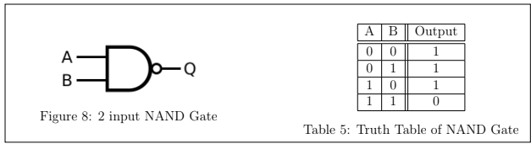

NAND Gate
Complement of AND. Only Low when all inputs are high.

Slide 14
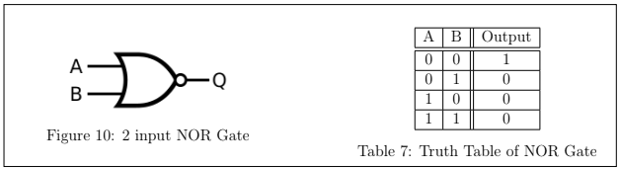

NOR Gate
Complement of OR. Only High when all inputs are low.

Slide 15
04
Exclusive Gates
True only under specific conditions of exclusivity

Slide 16
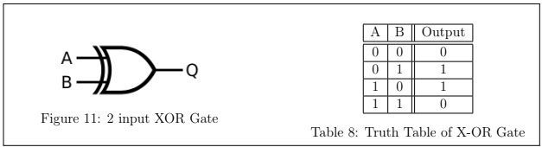

XOR Gate
Odd 1 selector

Slide 17
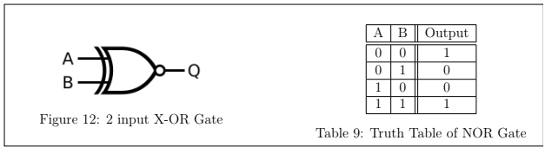
X–NOR Gate
Even 1 selector

Slide 18
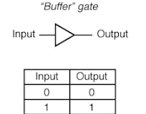
Buffer
A type of logic gate that amplifies a signal without changing its logic level.

Slide 19
Thank You !!
Feel free to ask any questions

